Slide 1
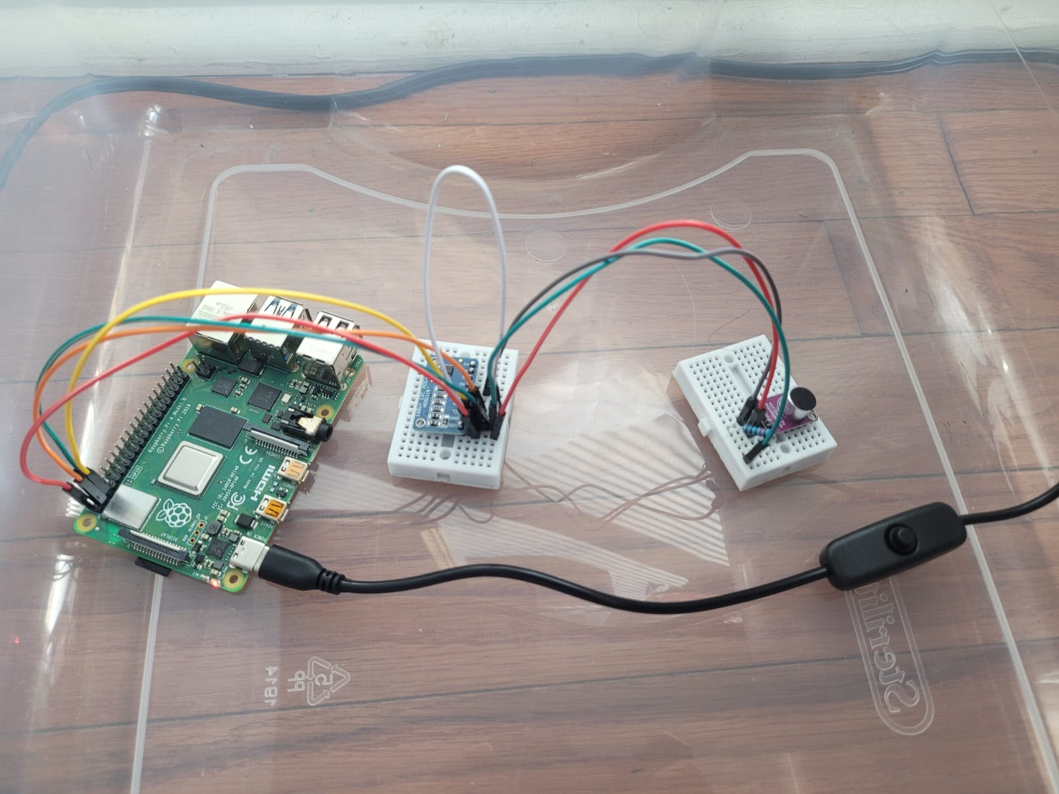

ADS1115
MAX4466 Microphone
$10kΩ$ Resistor
Wall Power Source
Rpi-4B

Slide 2
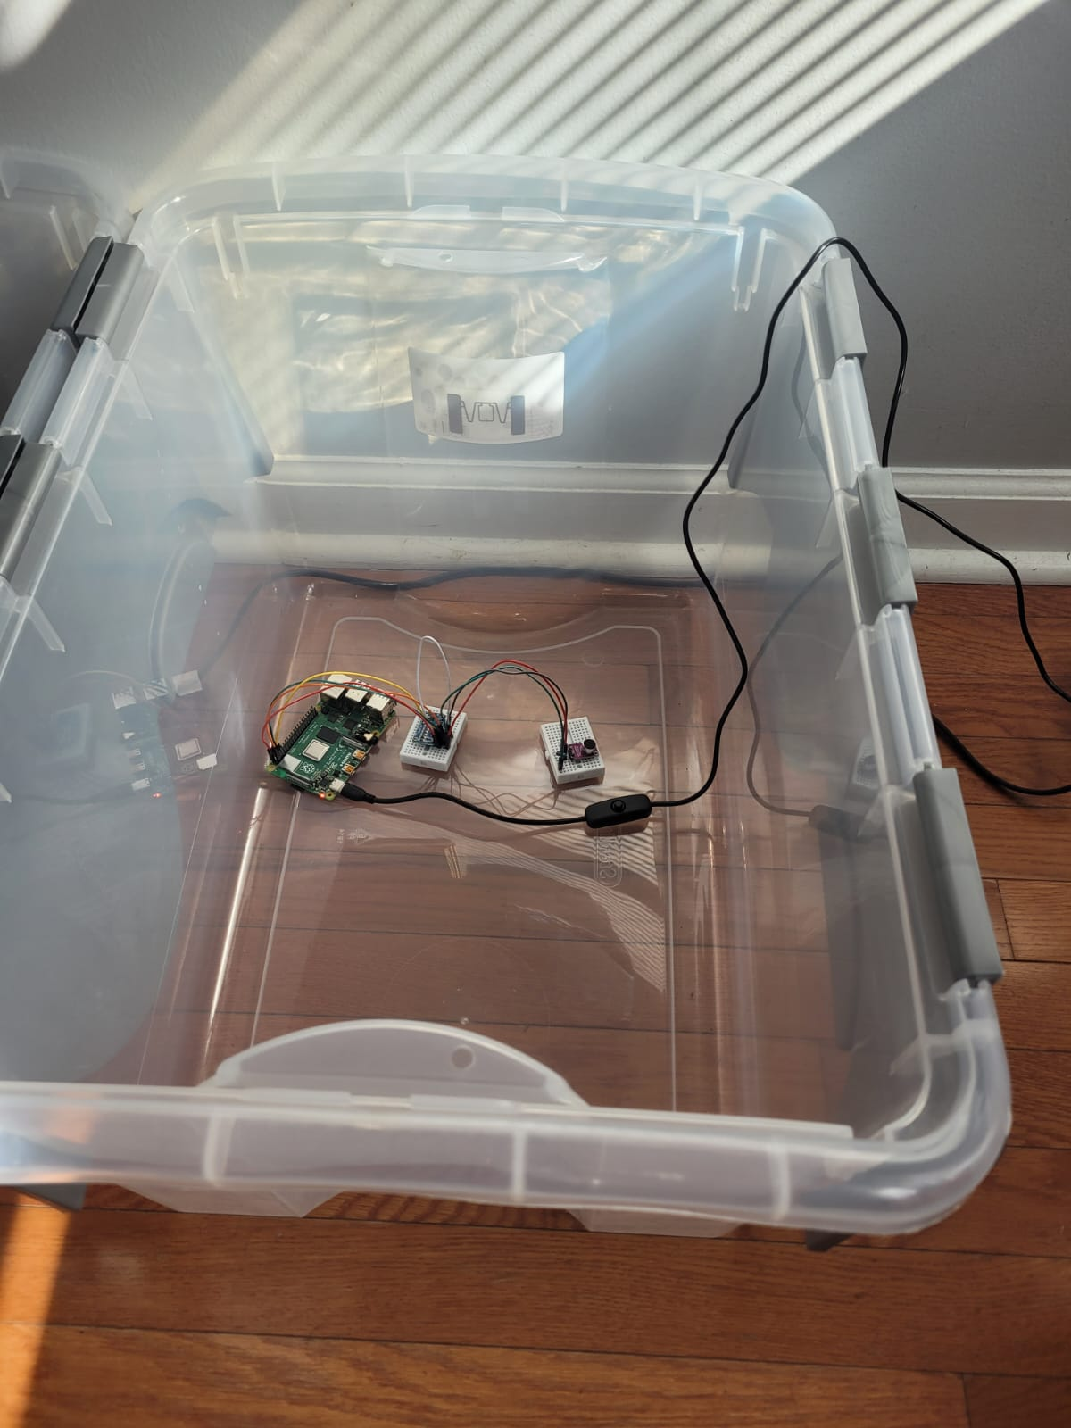
Box with closable lid

